Slide 1

Essentials of Economics
Seventh Edition
Chapter 13
Unemployment and Inflation
Copyright © 2021, 2019, 2017 Pearson Education, Inc. All Rights Reserved.
Notes:
If this PowerPoint presentation contains mathematical equations, you may need to check that your computer has the following installed:
1) MathType Plugin
2) Math Player (free versions available)
3) NVDA Reader (free versions available)

Slide 2
Chapter Outline
Part 1
13.1 Measuring the Unemployment Rate, the Labor Force Participation Rate, and the Employment-Population Ratio
13.2 Types of Unemployment
13.3 Explaining Unemployment

Slide 3
13.1 Measuring the Unemployment Rate, the Labor Force Participation Rate, and the Employment-Population Ratio
There are more than 300 million people in the United States and monitoring and reporting on their activities regularly would be very difficult and costly.
Instead, the U.S. Department of Labor reports estimates of employment, unemployment, and other statistics related to the labor force each month.
Labor force: The sum of employed and unemployed workers in the economy.
Of these statistics, the most watched is known as the unemployment rate: the percentage of the labor force that is unemployed.

Slide 4
The Household Survey
Each month, the U.S. Census Bureau conducts the Current Population Survey (a.k.a. the household survey).
~60,000 households selected to be “representative”
Household members of “working age” (16+ years old)
Asked about employment during “reference week”
Also asked about recent job search activities
People are then classified as:
Employed: In government statistics, someone who currently has a job or who is temporarily away from his or her job.
Unemployed: In government statistics, someone who is not currently at work but who is available for work and who has actively looked for work during the previous month.
Not in the labor force, if neither of the above apply

Slide 5
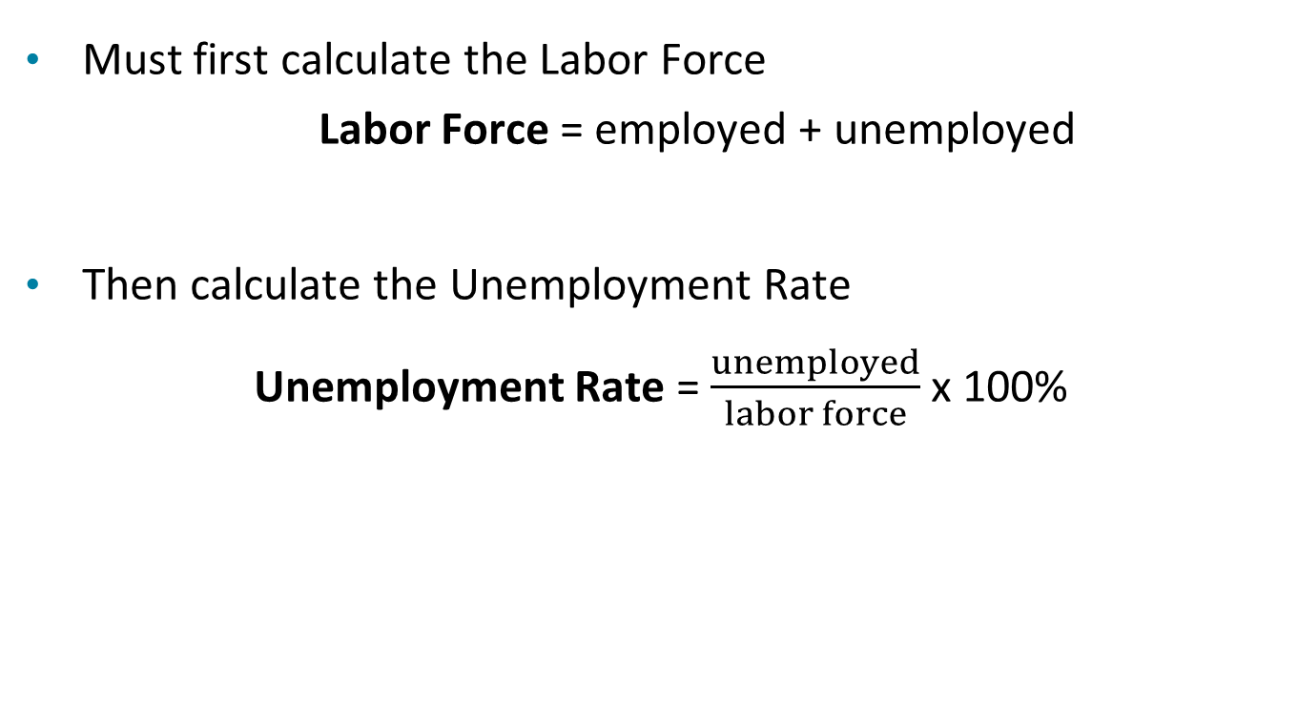
Calculating the Unemployment Rate
Must first calculate the Labor Force
Labor Force = employed + unemployed
Then calculate the Unemployment Rate
Unemployment Rate = $\frac{unemployed}{labor force}$ x 100%

Slide 6
Discouraged Workers and Hidden Unemployment
Discouraged workers: People who are available for work but have not looked for a job during the previous four weeks because they believe no jobs are available.
*Essentially, they have given up looking for a job.
Because discouraged workers are not accounted for in the official unemployment numbers, this is considered a type of hidden unemployment.

Slide 7
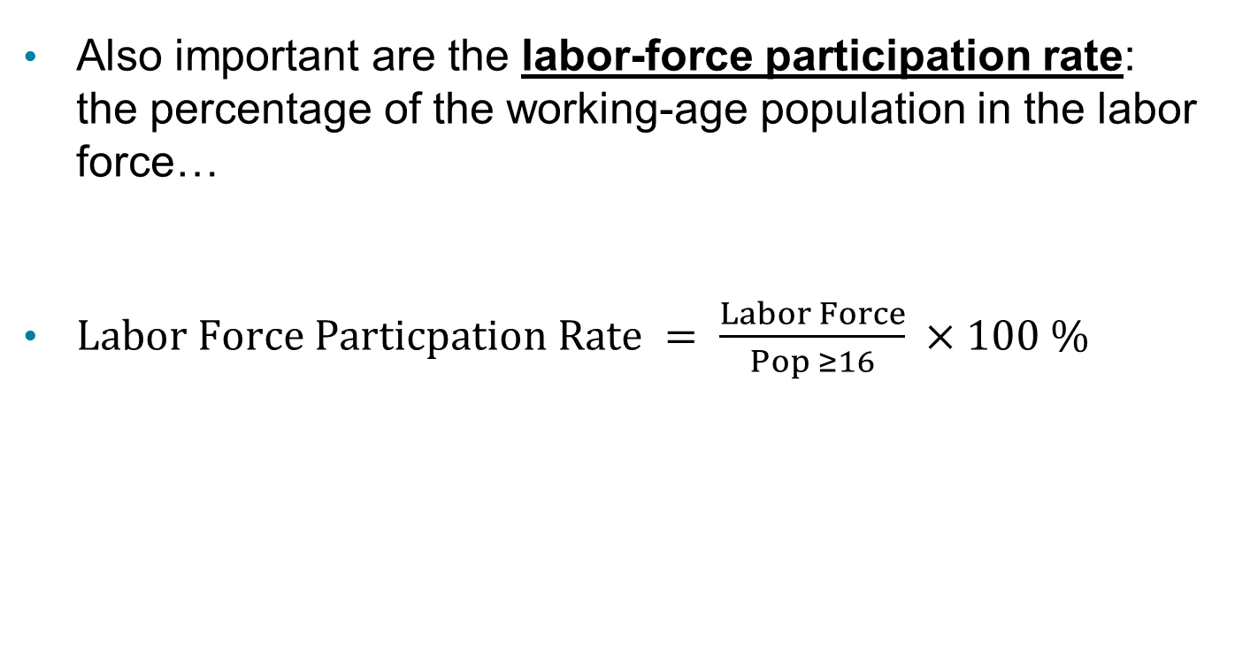
The Labor Force Participation Rate
Also important are the labor-force participation rate: the percentage of the working-age population in the labor force…
$Labor Force Particpation Rate = \frac{Labor Force}{Pop ≥16} ×100 \%$

Slide 8
Problems with Measuring the Unemployment Rate
The unemployment rate measured by the BLS is not a perfect measure of joblessness. Why?
It may understate unemployment:
Distinguishing between people who are unemployed and not in the labor force requires judgment (should we exclude “discouraged workers?’)
Only measures employment, not intensity of employment (full-time vs. part-time; some people are underemployed)
It may overstate unemployment:
People might claim falsely to be actively looking for work
May claim not to be working to evade taxes or keep criminal activity unnoticed

Slide 9
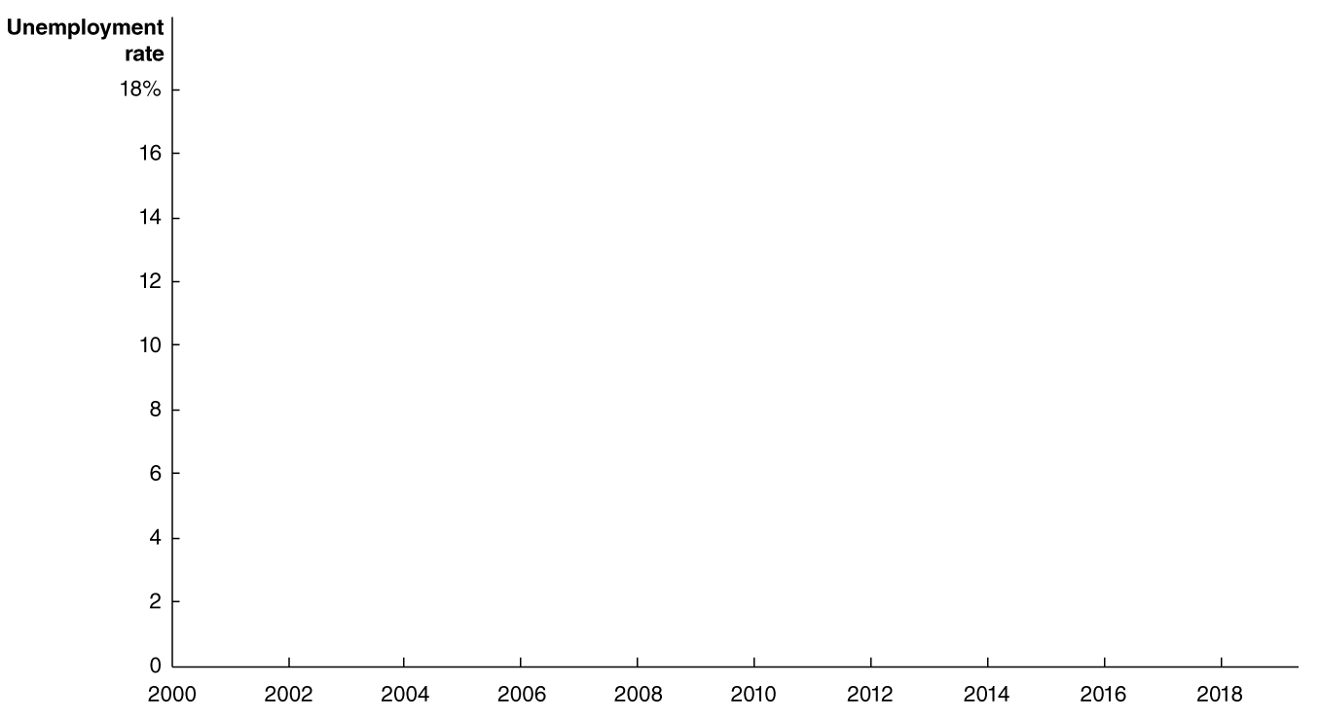
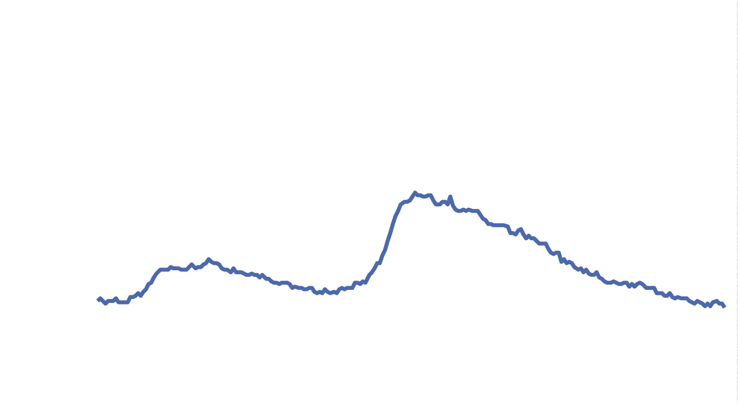
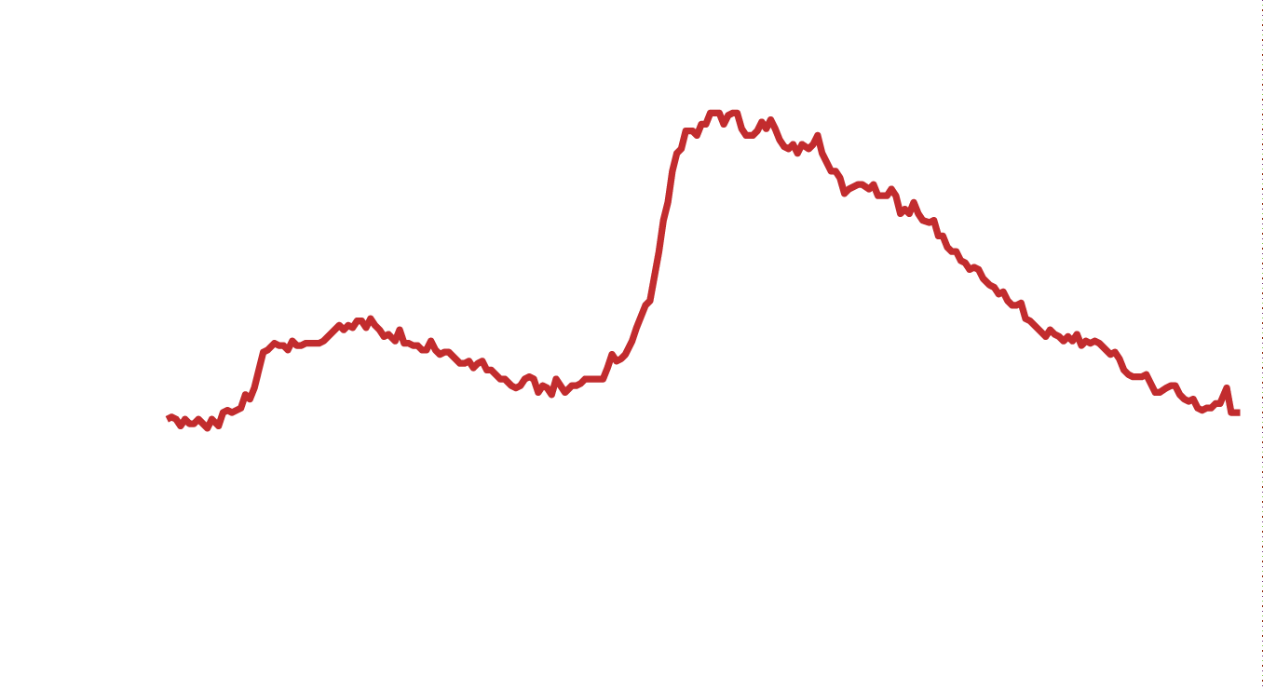
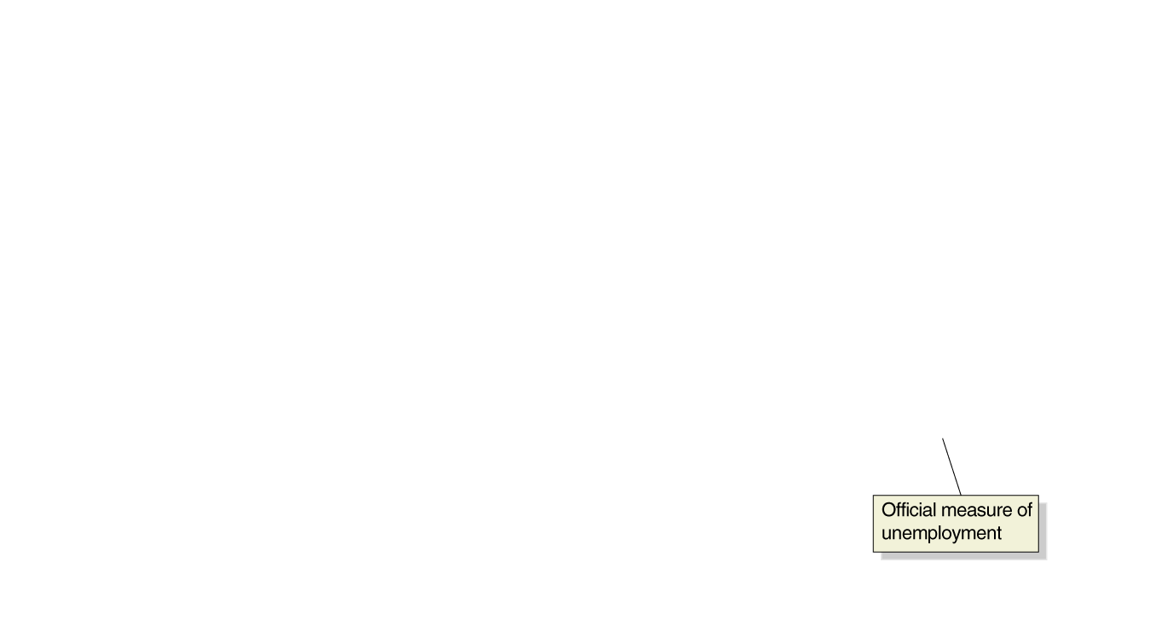
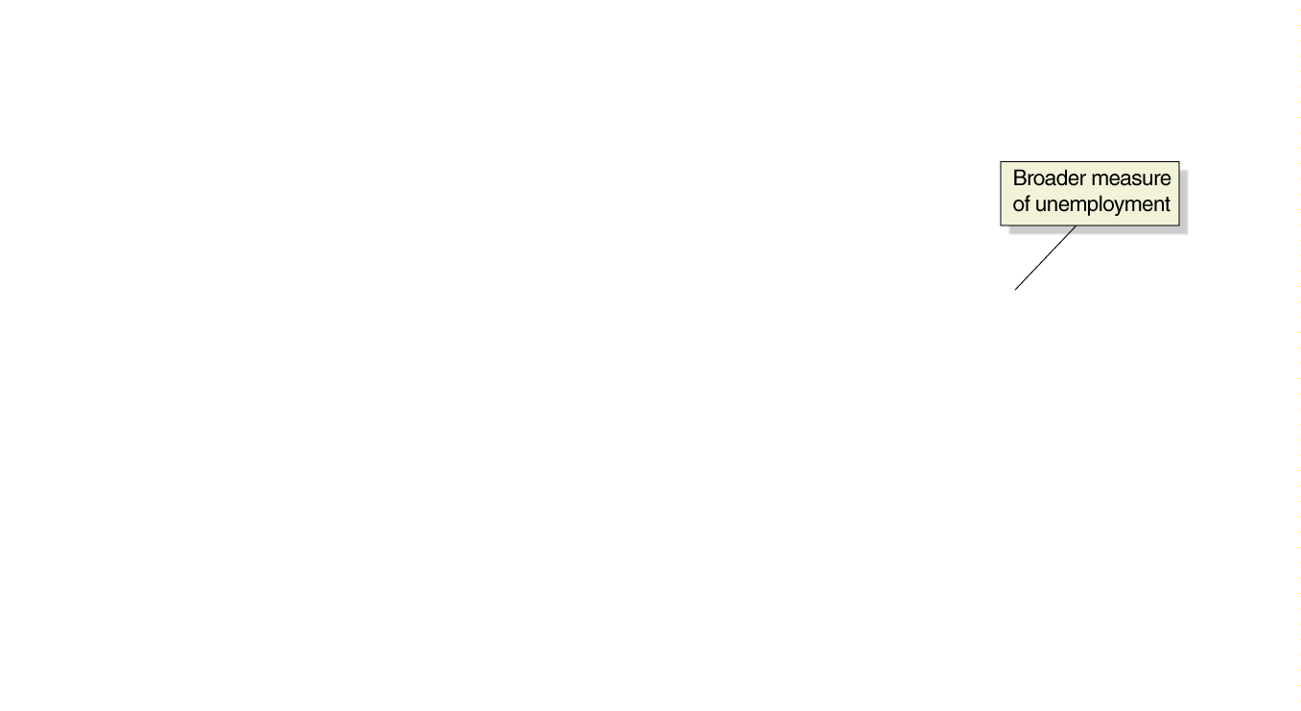

Figure 13.2 The Official Unemployment Rate and a Broad Measure of the Unemployment Rate, 2000-2019
Some people suggest that we should include discouraged workers and underemployed workers in the unemployment statistics, to create a broader measure of unemployment.
The BLS measures this, calling it BLS series U-6.

Slide 10
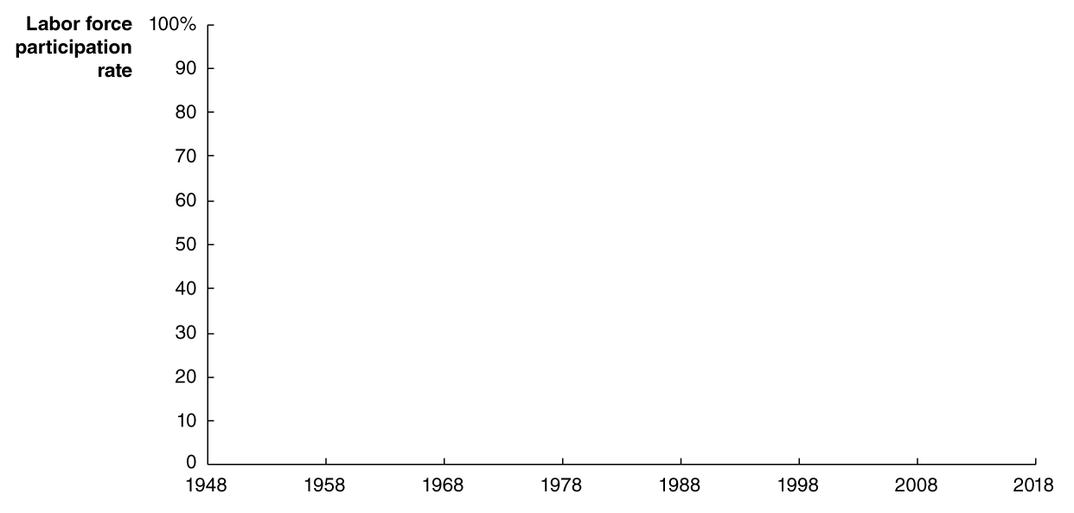
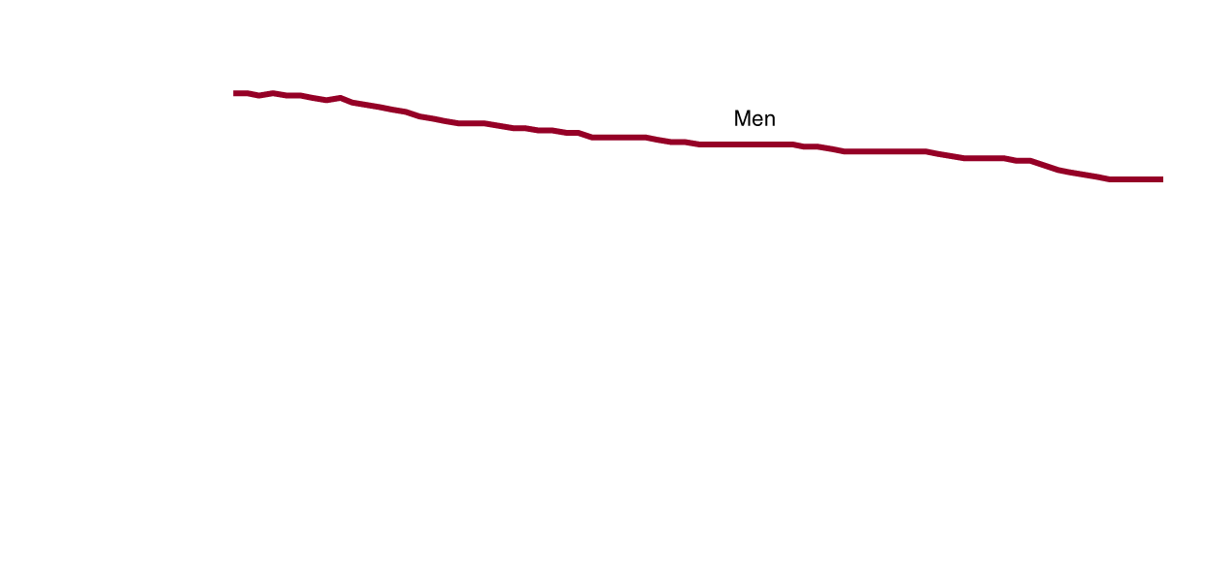
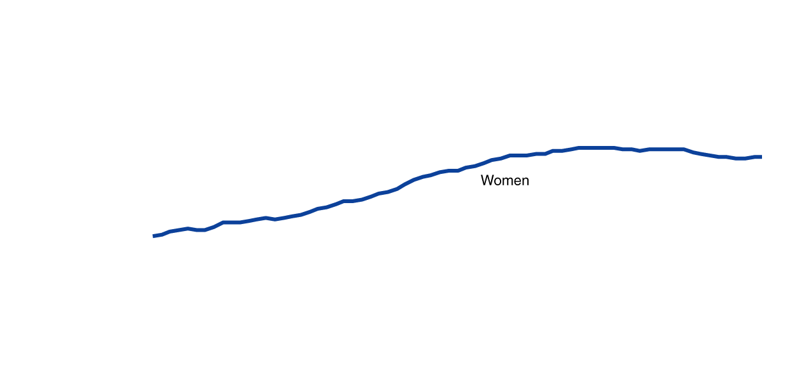
Figure 13.4 Trends in the Labor Force: Participation Rates of Adult Men and Women since 1948
The labor force participation rate of adult men has declined gradually since 1948…
… but it has increased significantly for adult women, making the overall rate higher today than it was then.
Recently, the rate for women has declined also.

Slide 11
The Establishment Survey
In addition to the household survey, the BLS also uses the establishment survey, (a.k.a. the payroll survey).
This survey samples ~300,000 establishments, or places of employment, about their employees. Disadvantages include:
Self-employed people not surveyed (not on a company payroll)
Newly opened firms often omitted
Information on employment only, not unemployment
Numbers fluctuate depending on establishments included, often requiring large revisions
However, a big advantage is that the data are determined by real payrolls, not self-reporting like the household survey.

Slide 12
Table 13.1 Household and Establishment Survey Data for March and April 2019
Blank | Blank | Household Survey | Blank | Blank | Establishment Survey | Blank
Blank | March | April | Change | March | April | Change
Employed | 156,748,000 | 156,645,000 | −103,000 | 150,832,000 | 151,095,000 | 263,000
Unemployed | 6,211,000 | 5,824,000 | −387,000 | Blank | Blank | Blank
Labor force | 162,960,000 | 162,470,000 | −490,000 | Blank | Blank | Blank
Unemployment rate | 3.8% | 3.6% | −0.2% | Blank | Blank | Blank
Even if all surveys are truthfully and accurately answered, we do not expect the numbers to be identical between the two surveys:
Different groups are measured
All surveys have measurement errors
But we get a more complete picture by considering both surveys.

Slide 13
Job Creation and Job Destruction over Time
Jobs are continually being created and destroyed in the U.S. economy.
In 2018, about 30.2 million jobs were created, while about 28.2 million jobs were destroyed.
This is a natural and normal process for the economy.
The BLS reports net changes in the number of people employed and unemployed; this does not fully represent how dynamic the U.S. job market really is.

Slide 14
13.2 Types of Unemployment
Identify the three types of unemployment.
The three types of unemployment are:
Frictional unemployment: Short-term unemployment that arises from the process of matching workers with jobs.
Structural unemployment: Unemployment arises from a persistent mismatch between the skills or attributes of workers and the requirements of jobs.
Cyclical unemployment: Unemployment caused by a business cycle recession.

Slide 15
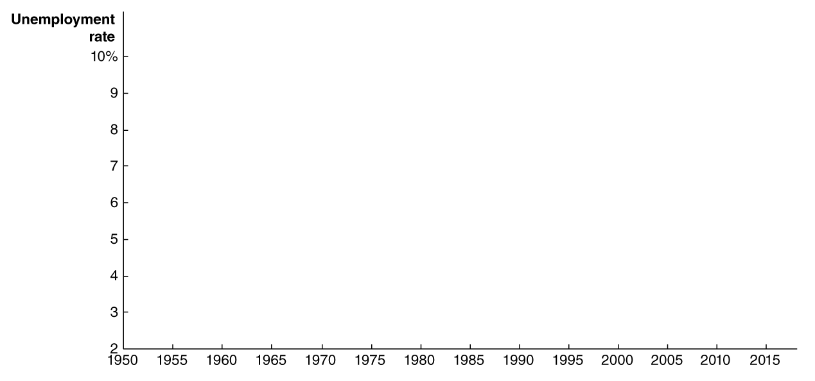
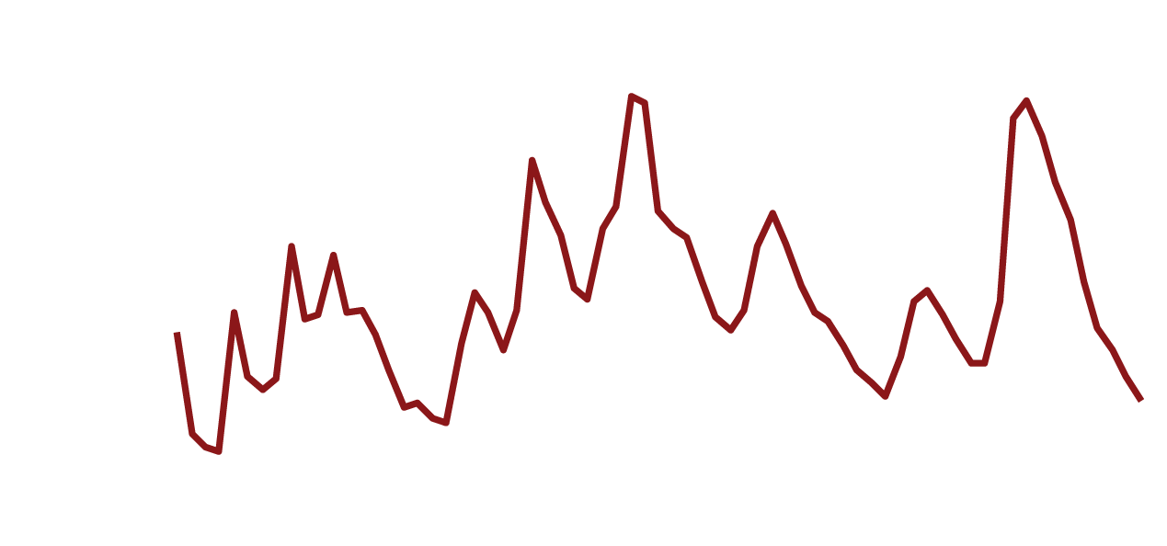

Figure 13.6 The Annual Unemployment Rate in the United States, 1950-2018
Unemployment rates rise when the economy is faltering and fall when the economy is doing well. But they never fall to zero.
The types of unemployment can help us to understand why.

Slide 16
Cyclical Unemployment and the Natural Rate of Unemployment
Cyclical unemployment: Unemployment caused by a business cycle recession.
In normal recoveries after a recession, unemployment due to cyclical factors will fall.
When all unemployment is due to frictional and structural factors, we say that the economy is at full employment. This means there will always be some unemployment in the economy.
Economists call this the natural rate of unemployment: The normal rate of unemployment, consisting of frictional unemployment and structural unemployment.
The general consensus of economists is that the U.S. natural rate of unemployment is somewhere between 4.0 percent and 5.0 percent.

Slide 17
Unemployment Insurance
Suppose you have just lost your job. You want to find another and have two main options:
Take a new low-paying job immediately or
Search for a better job
If unemployment insurance payments are available to you, you will probably be more likely to choose the second option.
In the U.S., unemployment insurance payments are typically not very generous, compared with other high-income countries; and there are relatively short time limits.
Unemployment benefits are more generous, and unemployment rates higher, in western European countries.
Do you think these facts are related?

Slide 18
Minimum Wage Laws
Federal minimum wage law was introduced in 1938: $0.25/hour.
In 2017, the federal minimum wage was $7.25/hour.
Many states and cities have higher minimum wages.
Example: In 2019, California’s minimum wage was $12.00/hour, and San Francisco’s minimum wage was $15.59/hour.
Studies suggest a 10 percent increase in the minimum wage reduces teenage employment by about 2 percent.
Overall effect on unemployment rate is probably small at current levels, since relatively few people earn minimum wage.

Slide 19
Labor Unions
Labor unions are organizations of workers that bargain with employers for higher wages and better working conditions.
Unions are probably not a significant cause of unemployment in the United States. While they raise the wage, only about 6.4 percent of private sector workers are unionized, limiting the effect that unions have on the wider economy.

Slide 20
Efficiency Wages
Efficiency wage: An above-market wage that a firm pays to increase workers’ productivity.
Firms want to get the best performance they can out of their workers.
Sometimes monitoring workers is difficult or costly; an alternative is to pay them a relatively high wage, making them motivated to perform well in order to keep their job.
These above-market wages are probably another reason why unemployment exists even when cyclical unemployment is zero.

Slide 21

Copyright

